Slide 1
REST and Scaffolding
Keith Cortis

Slide 2
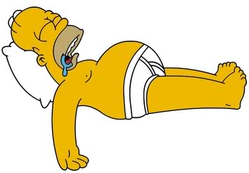
REST

Slide 3
REST
REpresentational State Transfer
Is an architectural style for developing Web applications
RESTful style of development: helps you make choices about which controllers and actions to write
Notes:
-REST:is a way to create, read, update or delete information on a server using simple HTTP calls.
-REST: in the context of Rails applications

Slide 4
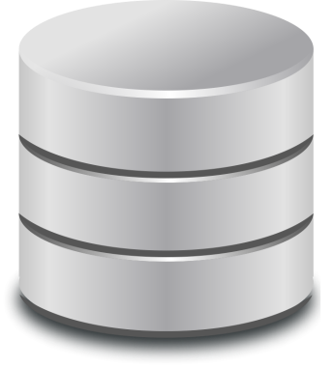
REST - Actions
Resource: Post
Create a new post
Read (View) a current post
Update (Edit) a current post
Delete a current post
Notes:
-Most application components (e.g., users and posts) are modeled as resources that can be Created, Read, Updated, and Deleted
-”Post” resource will be created by a scaffold generator program, which comes standard with each Rails project.

Slide 5
REST - Examples
URL | Action | Purpose
/posts/new | new (create) | create a new post
/posts/1 | show (read) | page to show post with id 1
/posts/1/edit | edit (update) | page to edit post with id 1
/posts/1 | destroy (delete) | delete a specific post with id 1
Notes:
-Most application components (e.g., users and posts) are modeled as resources that can be Created, Read, Updated, and Deleted

Slide 6
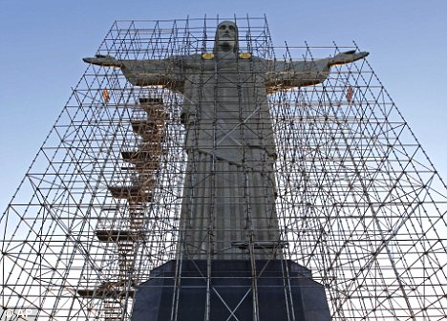
What is Scaffolding?
Notes:
-Scaffolding: structure used for construction of new buildings or re-construction of old ones
-Scaffolding: technique supported by some MVC frameworks
-Scaffolding in Ruby is used in the same way to build the structure of a web application

Slide 7
Scaffolding
Auto generation of the models, views and controllers for a new resource in one operation
E.g. of a resource: Post, User
Quick way to generate some of the main features of an application
Single line of code
rails generate scaffold Post title:string summary:text body:text
Brings database table to life
Notes:
-Resource is an object such as a post, user, etc.
-Mainly it will generate for you all the code/common things we need for a new resource, with a single line of code. includes basic actions: to create, read, update and delete an object
-Moreover this will also create the table in which the data will be stored (in rows) when the object is created

Slide 8
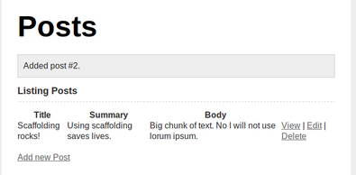
Scaffolding
Generate scaffold for a Post resource
Represents a single blog posting
Notes:
-The structure for this blog, was created by scaffolding through a single line of code

Slide 9
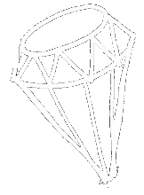
Rubies are a girl’s best friend Rails Girls Galway http://railsgirls.com/galway
Thanks!
Notes:
About me

